Slide 1

DSLab
The Data Science Lab
Data Science Lab – Spring 2019

Slide 2

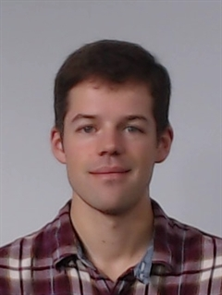



Introducing the team
Lia Bifano
Student Assistant
Guillaume Obozinski
Modules 1 & 5
Weeks 4, 12-14
Tao Sun
Student Assistant
Eric Bouillet
Most modules
Yazdanian Ramtin
Teaching Assistant
Data Science, DLAB
Mark Sutherland
Teaching Assistant
Parallel Systems Architecture
Christine Choirat
Module 1
Weeks 1-4
Rok Roksar
Module 3
Weeks 7, 8 & 9
Dorina Thanou
Module 1
Week 4
Sofiane Sarni
Module 4
Weeks 10 & 11
Apostolos Modas
Teaching Assistant
Signal Processing (LTS4)
Olivier Verscheure
Most modules

Slide 3

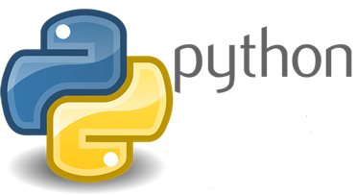



Instant quiz
Python & Anaconda
Jupyter Notebooks
Git(Lab/Hub)
Docker containers
Kaggle

Slide 4
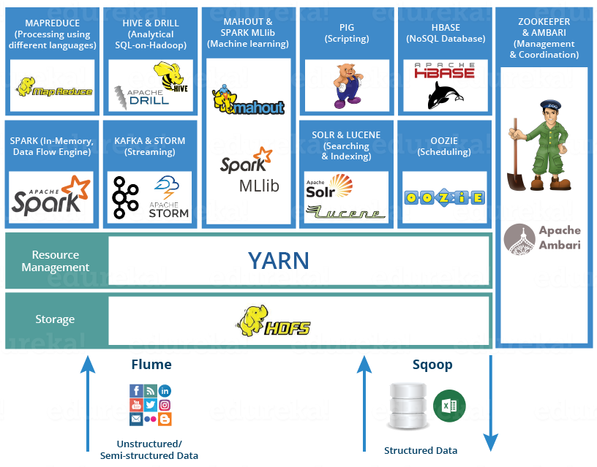
Instant quiz
Python & Anaconda
Jupyter Notebooks
Git(Lab/Hub)
Docker containers
Kaggle
HDFS, YARN, Hive
Zookeeper, Ambari
Spark (Streaming)

Slide 5
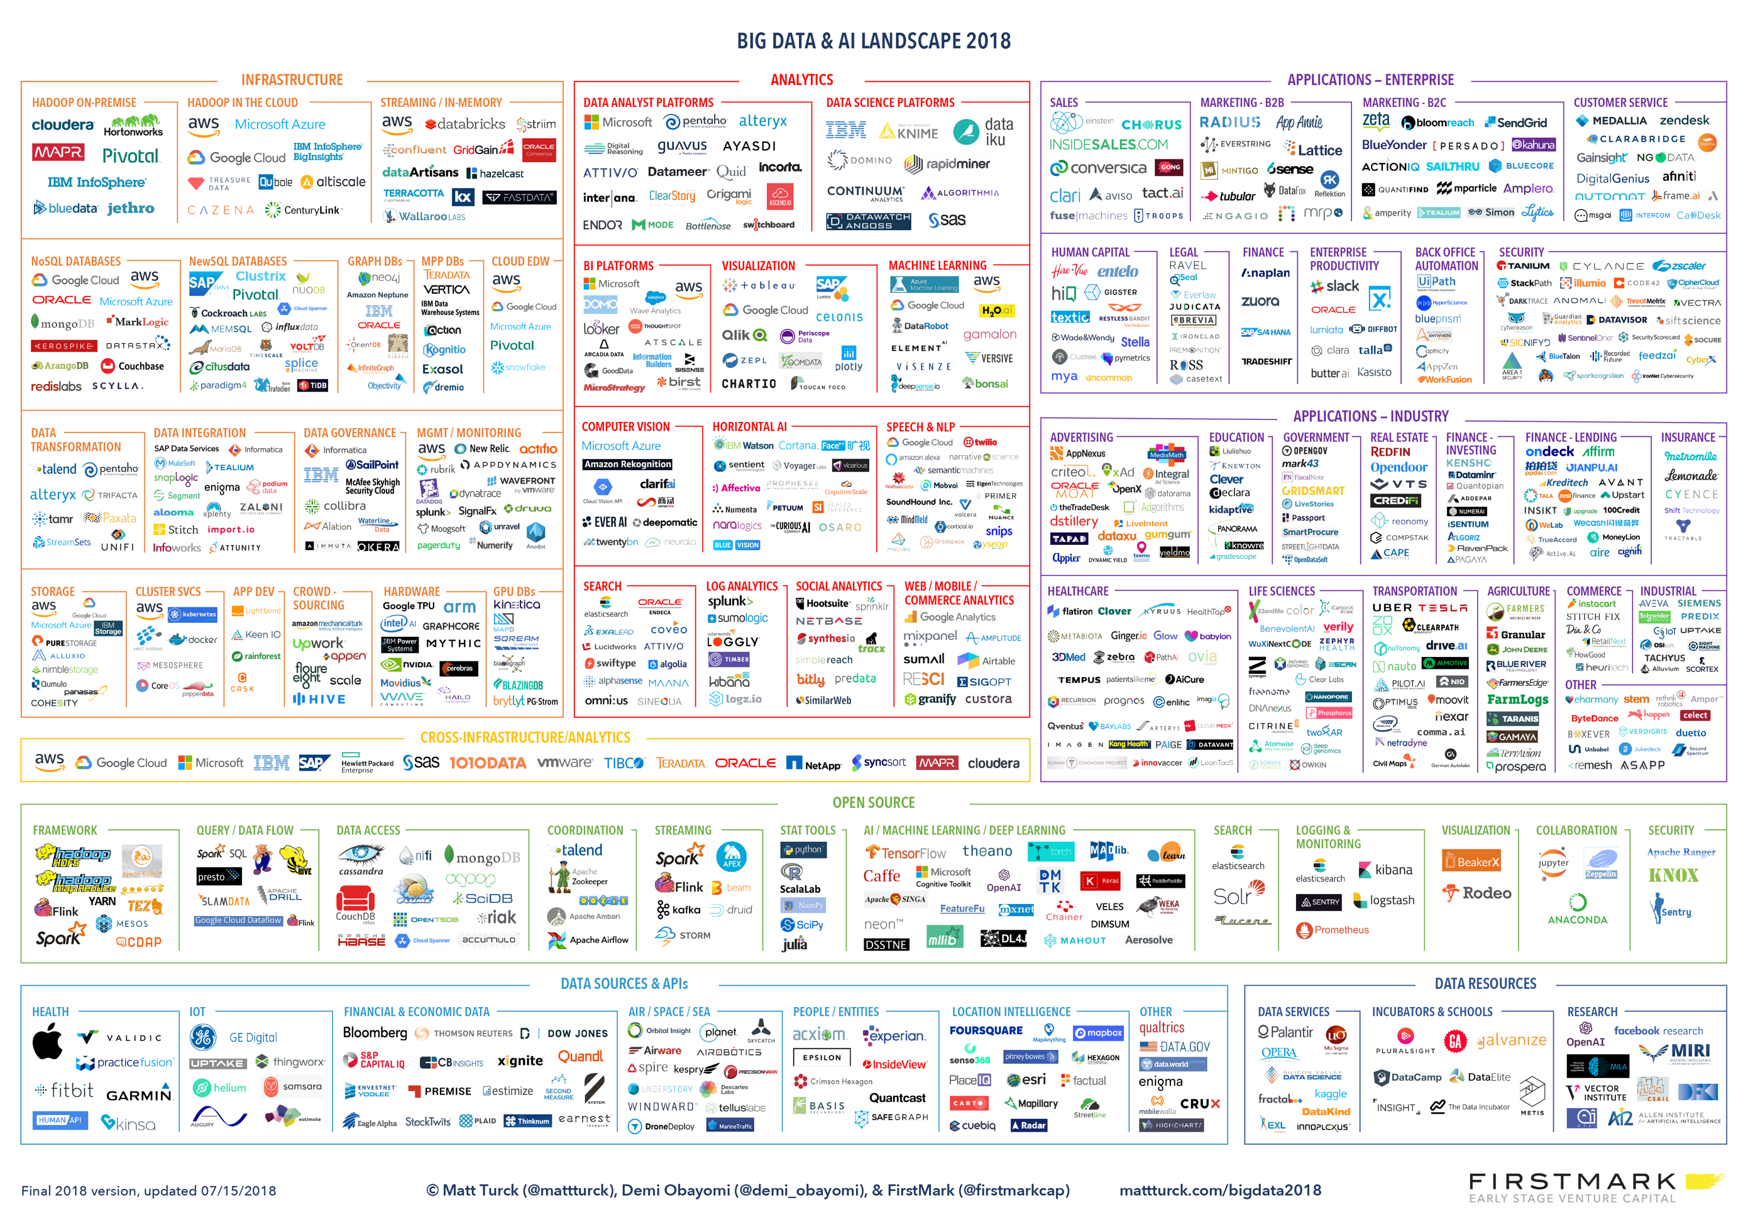
Data Science landscape 2018

Slide 6
Outline
A sobering introduction to data science
An overview of our DSLab
This week’s lab
Install python 3.x with Anaconda
Configure conda (virtualenv)
Crash course of Python 3.x in Jupyter Notebook

Slide 7
A Sobering Introduction to
Data Science

Slide 8



About me
Academia
Industry
New York
1999
17y
2016
2010
Dublin

Slide 9
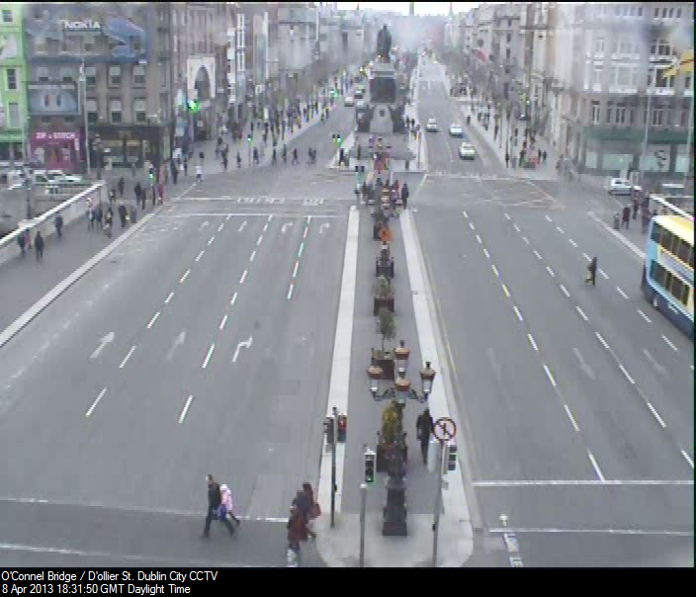
What do you see?

Slide 10
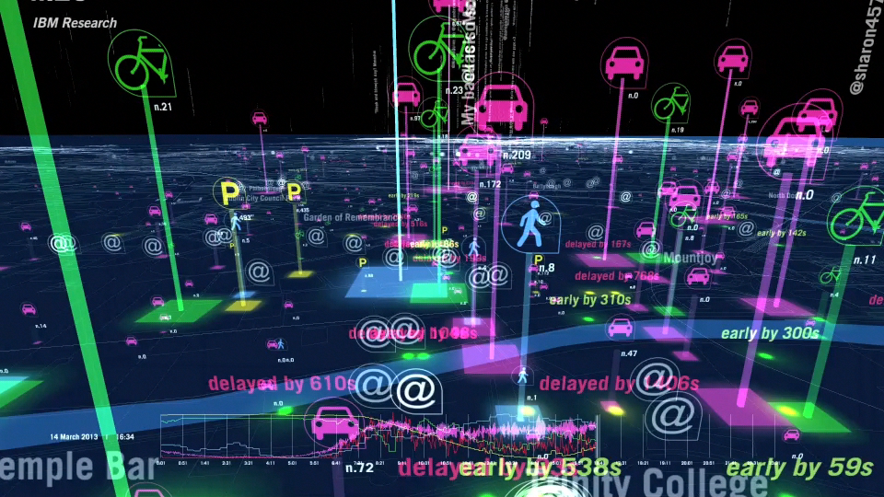
A fantastic source of data

Slide 11
Data is the new oil
The Economist, May 2017

Slide 12
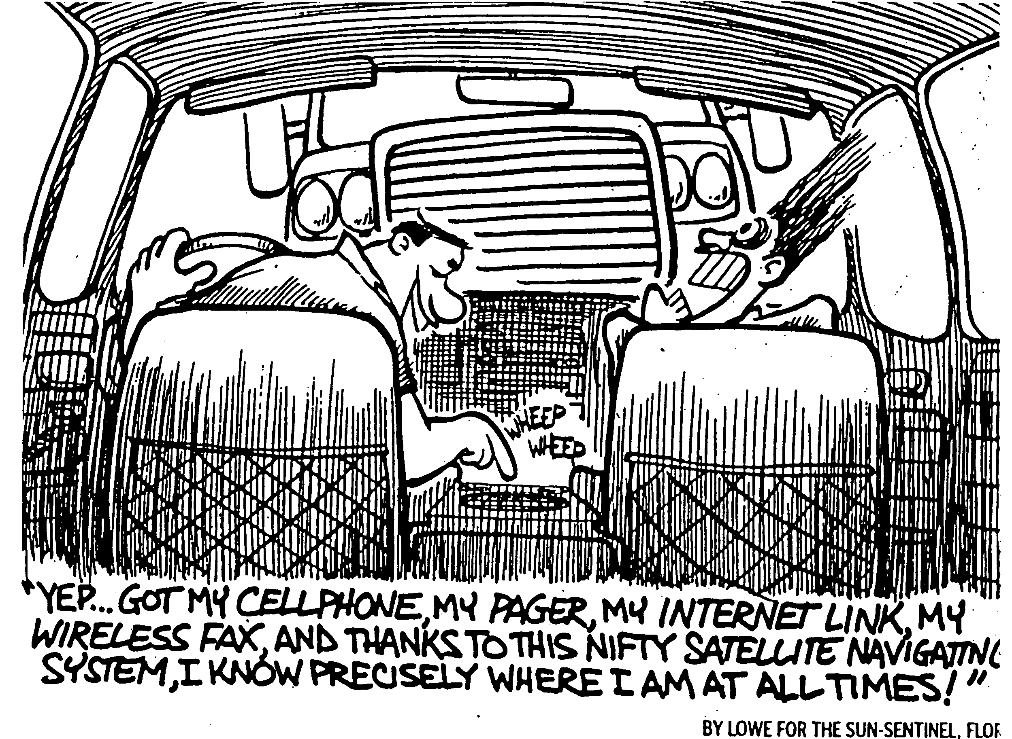
Big data, Bad data

Slide 13
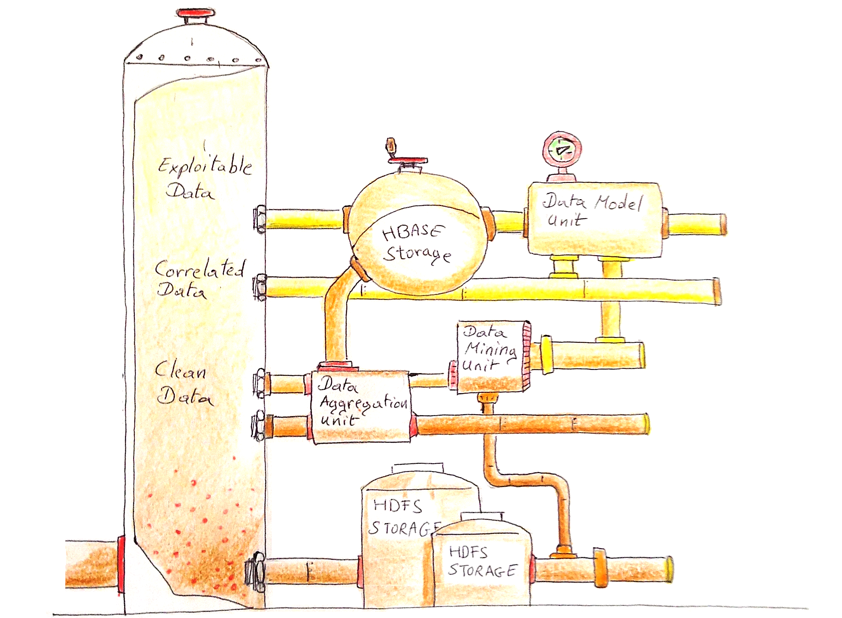
Like oil, data must be refined

Slide 14
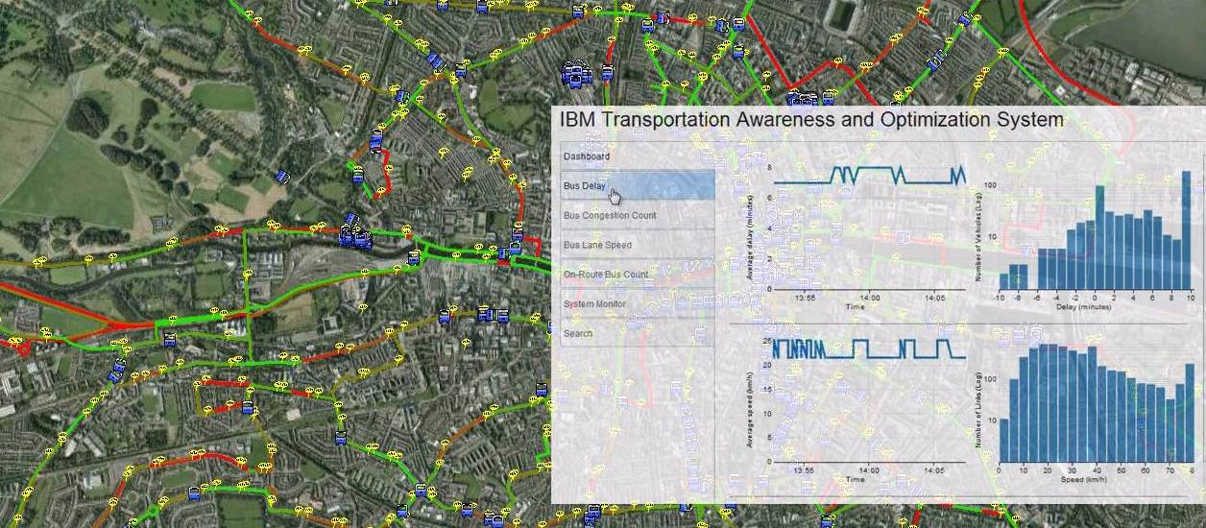

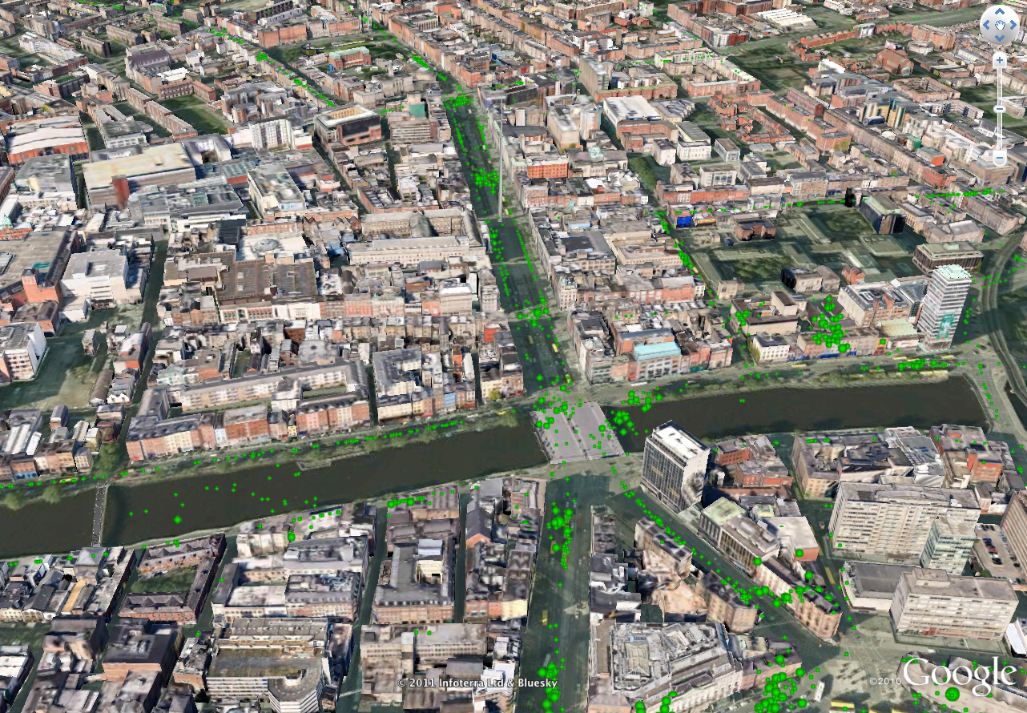
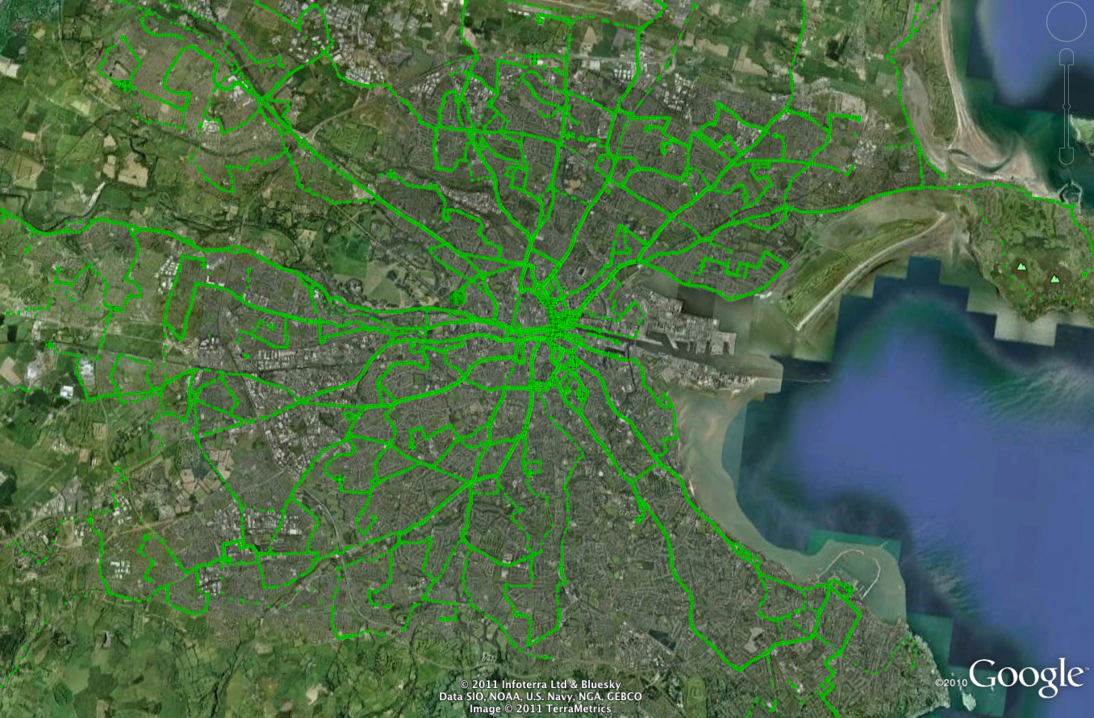
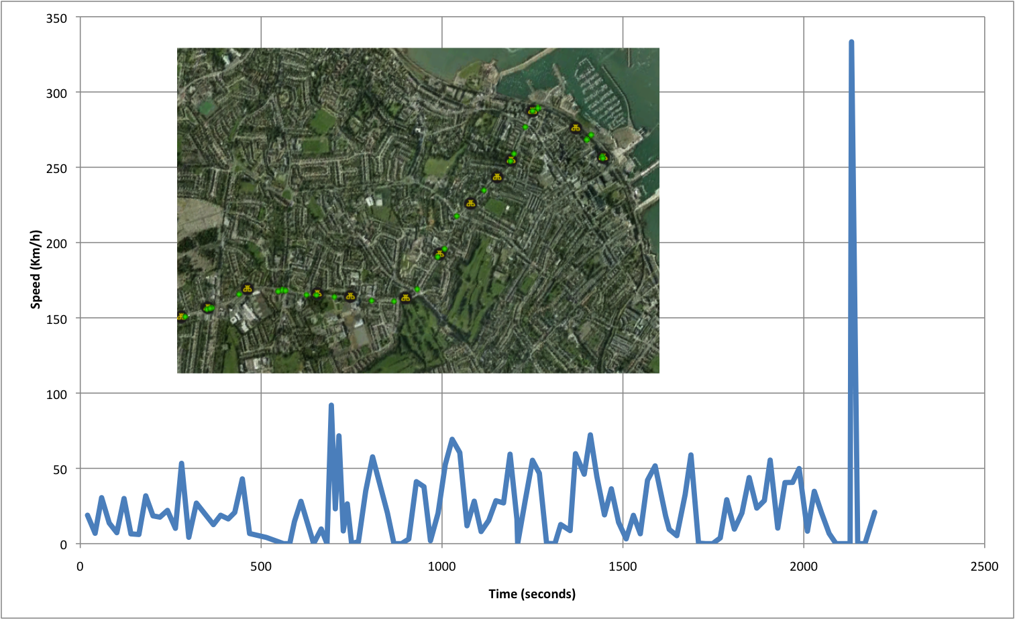
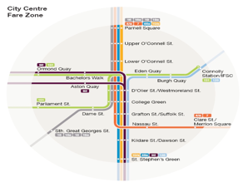
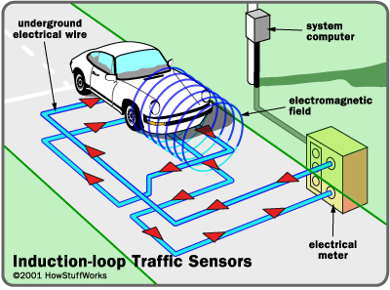




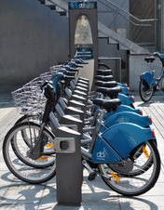
From raw data to information
Real-time tool for situational awareness
Parking capacity
Complex system & analytics challenges
Data diversity, heterogeneity
Data accuracy, sparsity
Data volume
700 intersections
4,000 loop detectors
20,000 tuples / min
Timetables
Car
Routes & maps
SCATS
Induction loop
1,000 buses
3,000 GPS / min
Accessibility
Bus AVL (GPS)
CCTV
200 CCTV cameras
Bike
“System and analytics for continuously assessing transport systems from sparse and noisy observations: Case study in Dublin” L. Gasparini, E. Bouillet, F. Calabrese, O. Verscheure, IEEE Conference on Intelligent Transport Systems, 2011.
Notes:
Diversity, heterogeneity → Static & dynamic, binary & text, etc.
Accuracy, sparsity → Sparsely populated
Volume
Assimilate most data sources

Slide 15
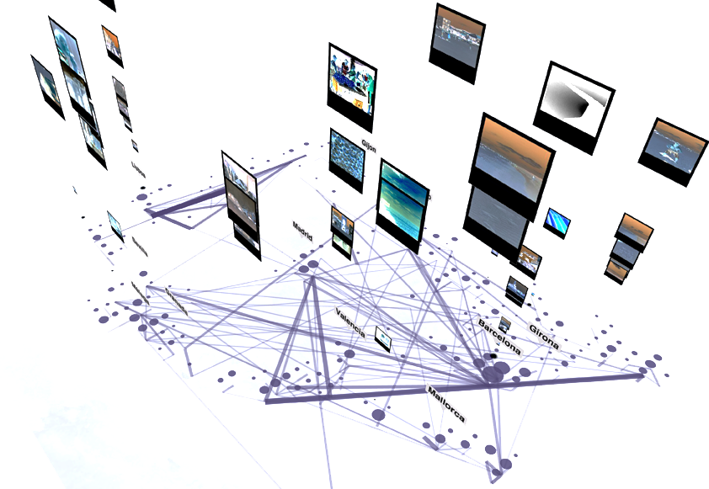

How can data science improve Urban Mobility?
From raw data to information
Assimilate complex sensor data
Deal with volume, accuracy, diversity

Slide 16
How can data science improve Urban Mobility?
From raw data to information
Assimilate complex sensor data
Deal with volume, accuracy, diversity
From information to models
Understand how people move
Model and predict demand

Slide 17
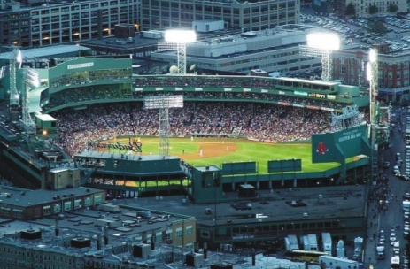

Modeling mobility during special events
Goal: Modeling and predicting origin-destination fluxes in the city during special events
“The geography of taste: analyzing cell-phone mobility and social events”, F. Calabrese, F. Pereira, G. Di Lorenzo, L. Liu, C. Ratti. International Conference on Pervasive Computing, 2010.

Slide 18
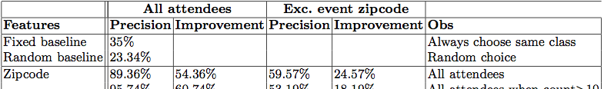
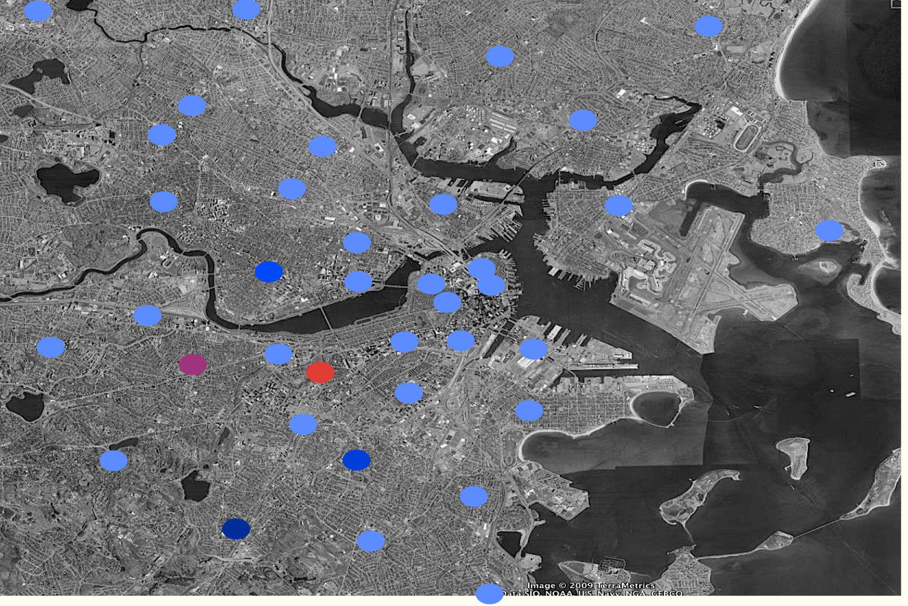
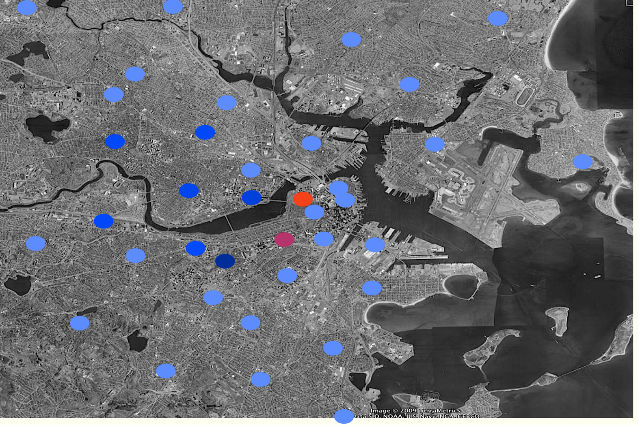
Predicting attendance origin
Low High
Attendance probability

Slide 19
How can data science improve Urban Mobility?
From raw data to information
Assimilate complex sensor data
Deal with volume, accuracy, diversity
From information to models
Understand how people move
Model and predict demand
From models to actions
Optimize planning & operations
Deal with uncertainty

Slide 20
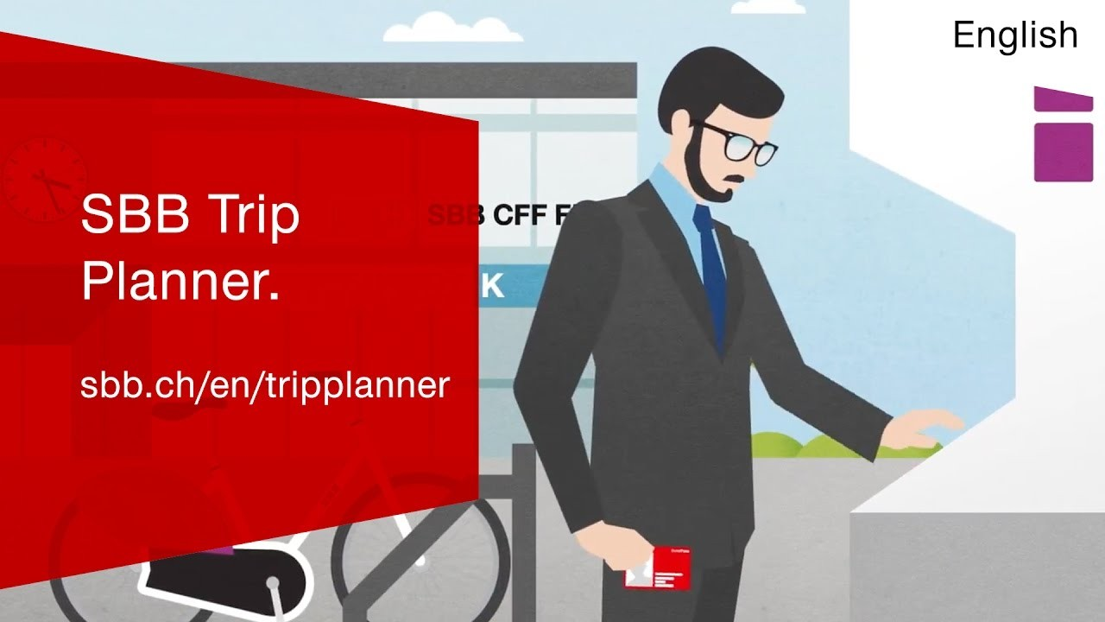
Multimodal journey planning

Slide 21
Today’s assumption of a deterministic world
Meeting Zurich HB @ 10:30… from St-Sulpice
6 minutes to catch train in Morges
16 minutes to catch train in Morges

Slide 22
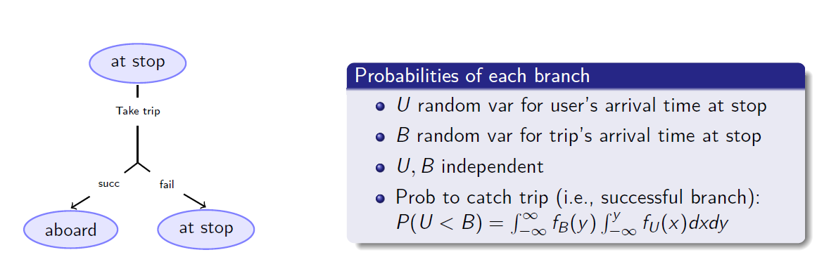
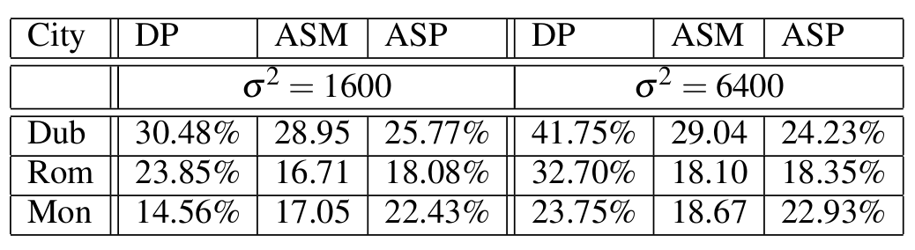
Uncertainty-aware vs Deterministic planning
Standard AO* fails to scale !
Weighted AO* with search enhancements
Pruning rules based on state dominance
Partial order reduction
Heuristics to guide search
ASM = Average savings per trip in minutes when differences occur
ASP = Average savings per trip as a percentage when differences occur
“Multi-Modal Journey Planning in the Presence of Uncertainty”, A. Botea, E. Nikolova, M. Berlingerio. Twenty-Third International Conference on Automated Planning and Scheduling, 2013
Notes:
04/10/12
22
04/10/12
22

Slide 23
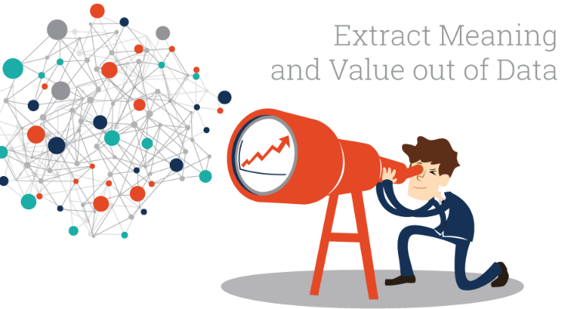

Data Science, a fragmented ecosystem
Data mining
DOMAIN
EXPERTS
Algorithms
Statistics
Personalized health
Smart cities
Environmental sciences
Material sciences
Social sciences
Economics
Digital humanities
DATA
SCIENCE
Data
management
GAP
Machine learning
Visual analytics
Operations research
How can I best match the right drug with the right dosage to the right patient at the right time?
Visualization
What is the hyperplane that best separates two classes of points in multidimensional space?

Slide 24
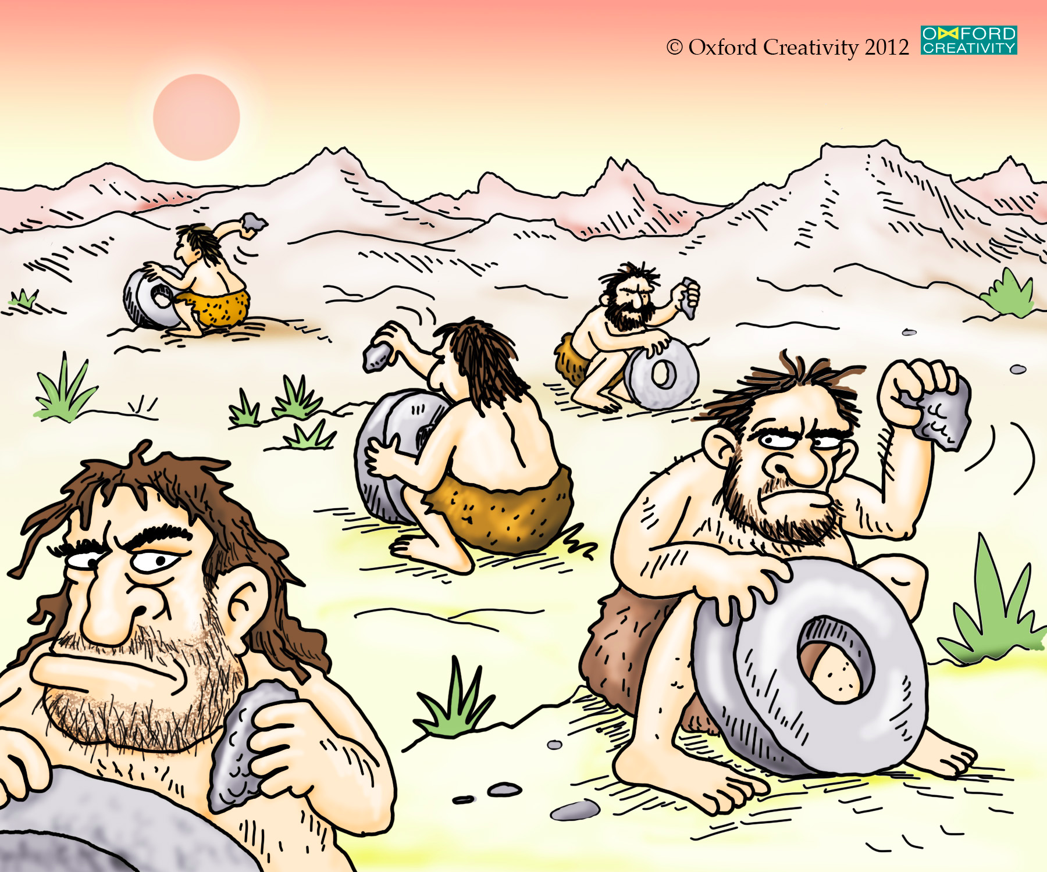
Status Quo in Data Science
credit: oxford creativity, https://www.triz.co.uk/
Notes:
Work in silos, unaware of insights generated by others – from data in silos to work done in silos
Communication barriers, among humans & machines
R&D not always traceable / verifiable
Data and methods often not reusable
Scientific progress hampered by frequent re-inventions of the wheel

Slide 25
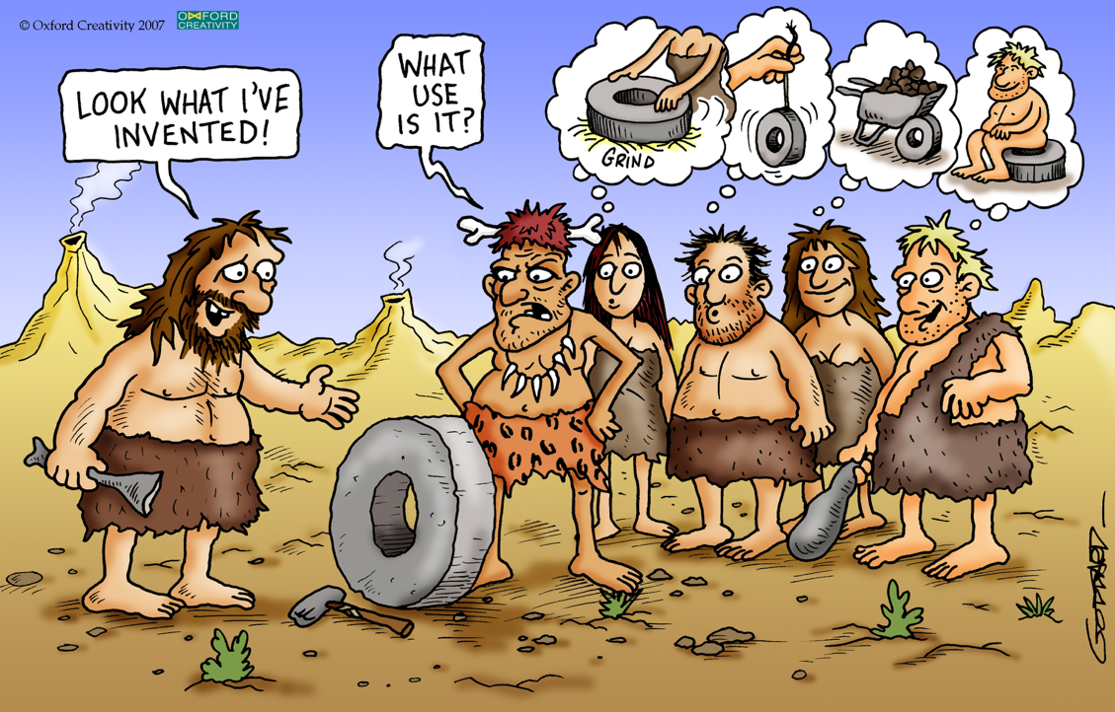
Facilitate communication to foster innovation
credit: oxford creativity, https://www.triz.co.uk/

Slide 26
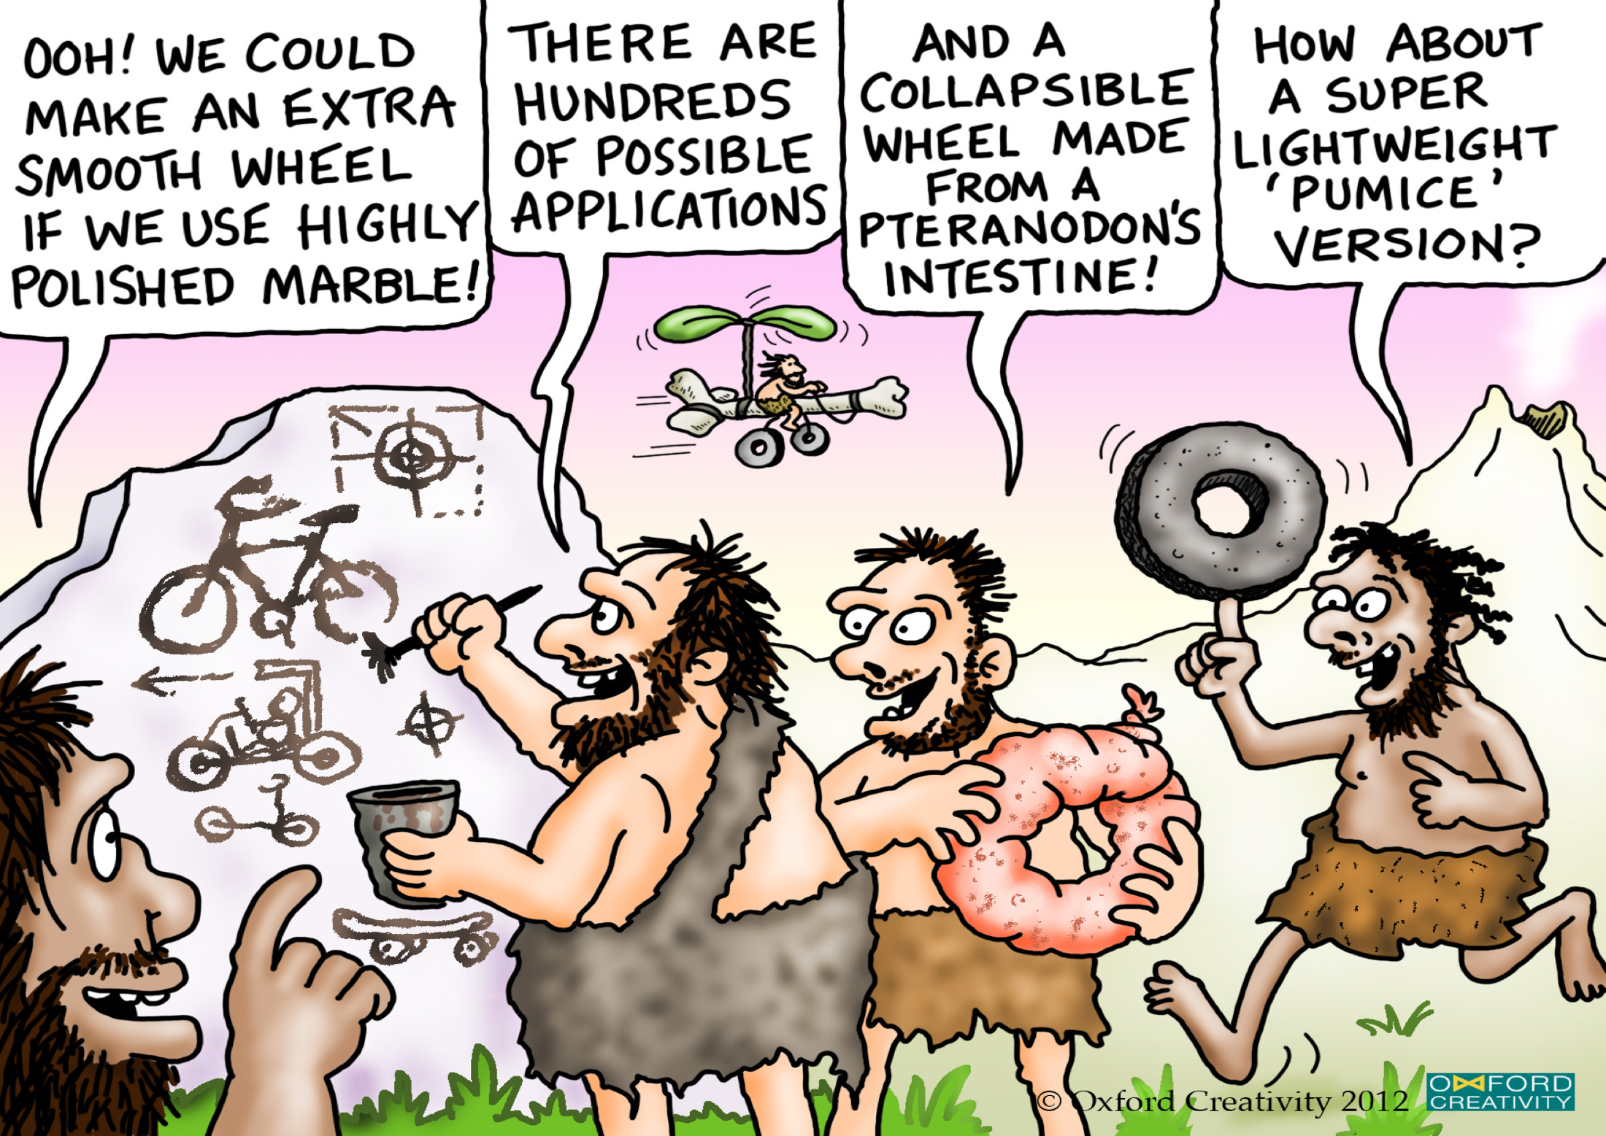
… to foster multidisciplinary collaborations
credit: oxford creativity, https://www.triz.co.uk/

Slide 27

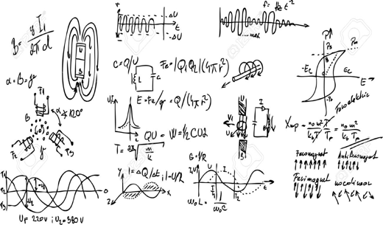
The Swiss Data Science Center (SDSC)
Foster adoption of data science both in academia and industry
How can I best match the right drug with the right dosage to the right patient at the right time?
Domain experts
How is my data protected?
How private is it?
How exactly is it used?
What is the hyperplane that best separates two classes of points in multidimensional space?
Data scientists
Data providers
Notes:
federate data providers, data and computer scientists, and subject-matter experts
foster scientific breakthroughs with significant societal impact.

Slide 28
A key actor in a complex ecosystem
Domain expertise
Healthcare
Mobility & Public Transportation
Investment Banking & Finance
Intelligent Manufacturing
Swiss Data Science Center
Applied
Research
Basic Research in
Data science
Smart sensing
Data security
& privacy
Statistics
Machine learning
Operations
research
Visualization
Notes:
Each academic discipline could be associated to labs on the ETH Domain
Now, along the other dimension… from basic research in data science to… domain science where domain expertise lies
There is a gap. If you want to solve a real problem in one of the domains, things can get tricky. Especially because many real-world problems in data science are multidisciplinary by nature, and that labs focus deep on a specific academic discipline.
With this rather large definition of data science, about 100 labs from the ETH Domain are active in data science

Slide 29
An overview of our lab

Slide 30

4+1 Modules in 14 weeks
Crash-course in Python for data scientists (4 weeks)
Distributed computing with a Hadoop Distribution (2 weeks)
Distributed processing with Apache Spark (3 weeks)
Real-time data acquisition and processing (2 weeks)
Data science as a journey!
Very hands-on and practical
3+ instructors for every lab
Final project (3 weeks)
credit: oxford creativity, https://www.triz.co.uk/

Slide 31
Assessment
60% continuous assessment during the semester
One project per module (last week)
Groups of 3 students
Projects graded within 2 weeks
40% final project
3-week project in the classroom
Groups of 4+ students
credit: oxford creativity, https://www.triz.co.uk/

Slide 32
Hardware / Software Resources
Please bring your own laptop!
Hadoop Cluster from week 5
Hortonworks Data Platform
IC Cluster of 16+ servers
credit: oxford creativity, https://www.triz.co.uk/
Notes:
HDP: HortonWorks Data Platform

Slide 33
Logistics
Lab on Wednesday’s 13:00 – 16:00 in INF 01
Lab’s github: https://dslab2019.github.io/
Office hours TBD
Mattermost - ?

Slide 34
Module 1: Crash-course in Python for data scientists
Week #1
Jupyter Notebooks
Python 3.x
Week #2
NumPy, Pandas, Matplotlib, Scikit-Learn
Week #3
Git, Docker, Kaggle
Week #4
Assessed project
Outlier detection in CO2 signals from geolocalized sensors
credit: oxford creativity, https://www.triz.co.uk/
Notes:
HDP: HortonWorks Data Platform

Slide 35
Module 2: Distributed computing with Hadoop
Week #5
Overview bundled components
Configuration best practices & guidelines
Week #6
Loading & querying data with Hadoop
Assessed project
Scaling up to Hadoop cluster
credit: oxford creativity, https://www.triz.co.uk/

Slide 36
Module 3: Distributed processing with Apache Spark
Weeks #7
Introduction to distributed computing and the Spark runtime architecture
Learn Python features needed for efficient Spark
Use basic RDD manipulations to construct an N-gram viewer of the Gutenberg book corpus
Bonus: learn to transform data to use the Spark machine learning library
Week #8
Finish project from past week
Spark DataFrames
Week #9
Assessed project
Use DataFrames for mining a Twitter archive
credit: oxford creativity, https://www.triz.co.uk/
Notes:
Resilient Distributed Datasets (RDD) is a fundamental data structure of Spark.

Slide 37
Module 4: Real-time data acquisition and processing
Week #10
Overview of MQTT as sensor protocol
Apache NiFi for IoT data collection
Apache Kafka for stream processing
Week #11
Assessed project
Process streaming data from real-time train geolocation data
credit: oxford creativity, https://www.triz.co.uk/
Notes:
s

Slide 38
Module 5: Final assignment
Robust Journey Planning
credit: oxford creativity, https://www.triz.co.uk/
Notes:
s

Slide 39
Today’s assumption of a deterministic world
Meeting Zurich HB @ 10:30… from St-Sulpice
6 minutes to catch train in Morges
16 minutes to catch train in Morges

Slide 40
Uncertainty-aware vs Deterministic planning
Standard AO* fails to scale !
Weighted AO* with search enhancements
Pruning rules based on state dominance
Partial order reduction
Heuristics to guide search
ASM = Average savings per trip in minutes when differences occur
ASP = Average savings per trip as a percentage when differences occur
“Multi-Modal Journey Planning in the Presence of Uncertainty”, A. Botea, E. Nikolova, M. Berlingerio. Twenty-Third International Conference on Automated Planning and Scheduling, 2013
Notes:
04/10/12
40
04/10/12
40

Slide 41
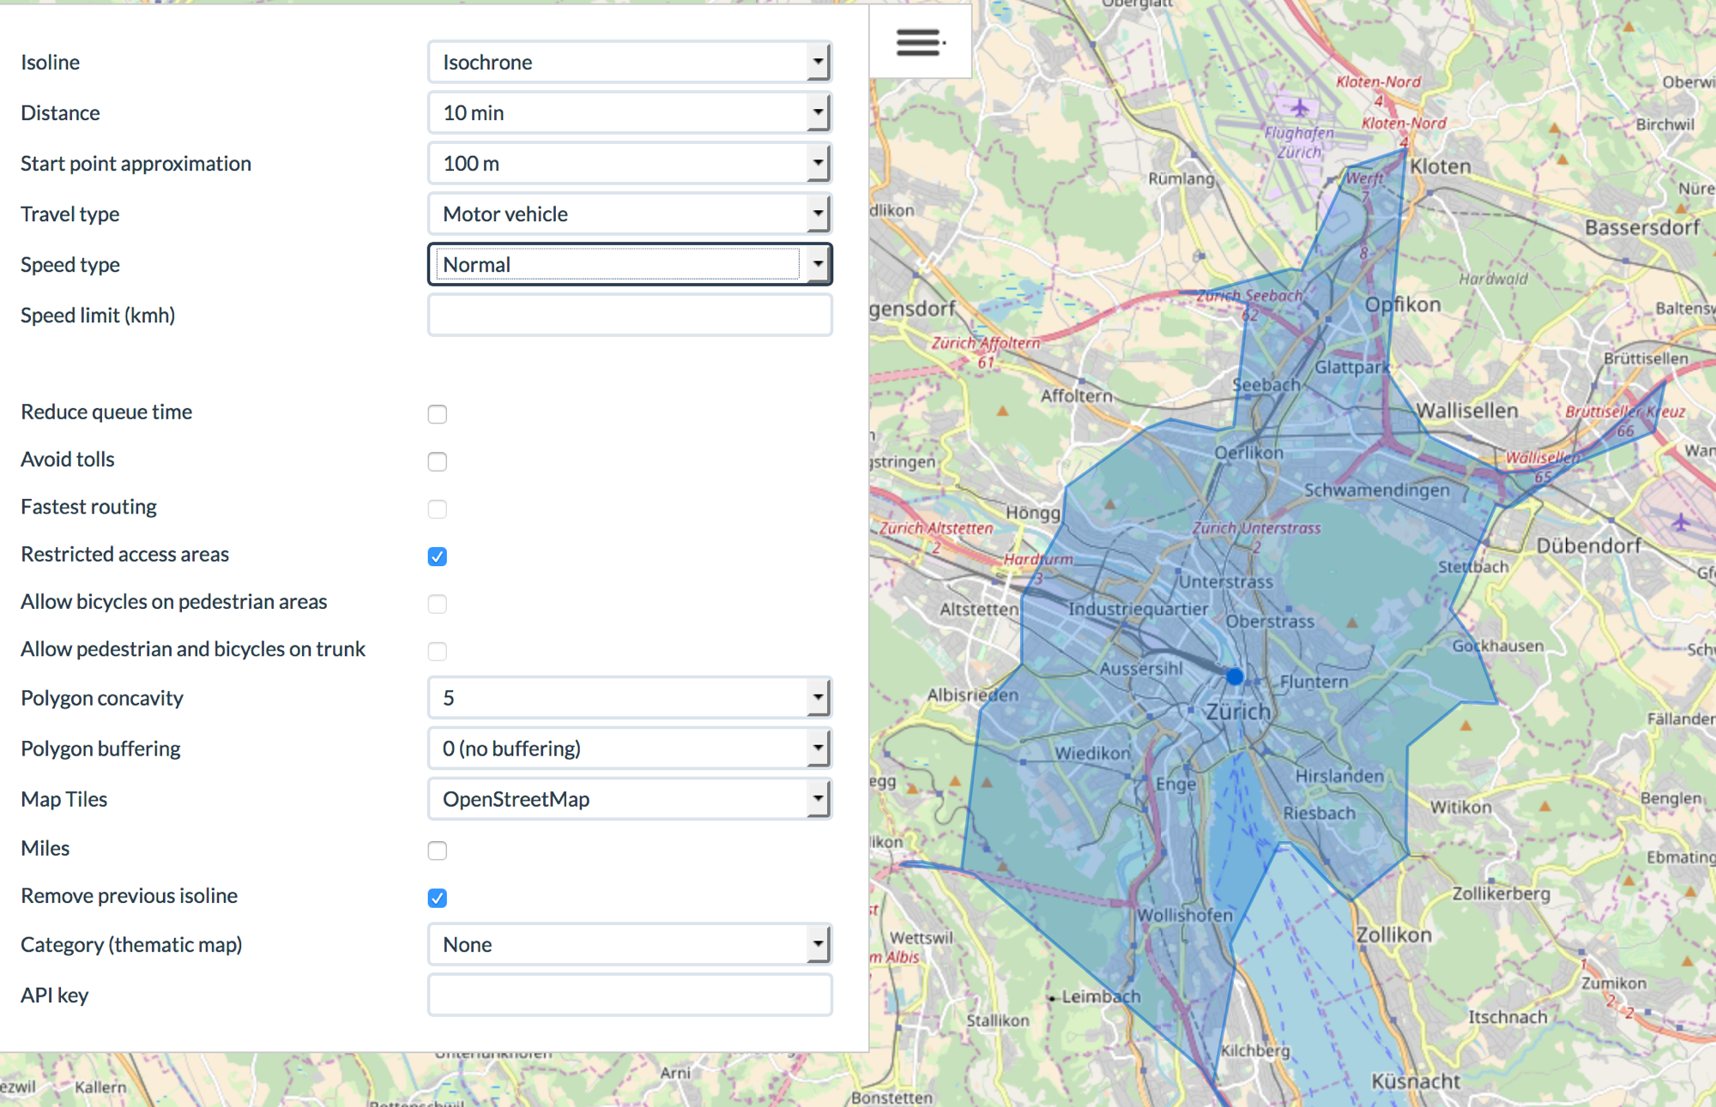
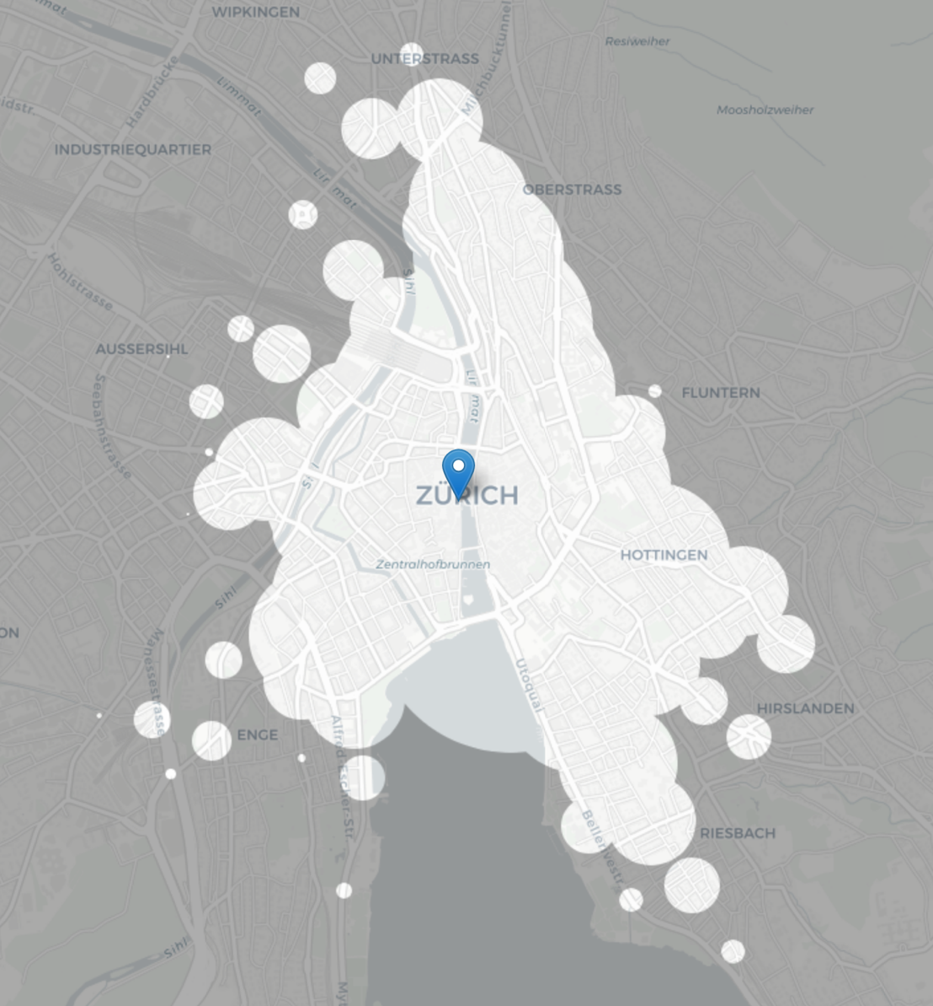
Overall objective
Display isochronous map
Start your journey e.g. at Zurich HB
How far can you go within M minutes Q% of the time?

Slide 42
Detailed description
https://github.com/dslab2019/dslab2019.github.io/tree/master/labs/week12

Slide 43
Overview Jupyter notebook Crash course Python 3.x
Spring 2019 - week #1
Notes:
J

Slide 44
Start your engines
Head over to the lab webpage
https://dslab2019.github.io/
Install python 3.x with Anaconda
Configure conda (virtualenv)
Open a terminal
Run: jupyter notebook
Notes:
conda --version
conda update conda
conda info --envs or conda env list
conda create --name DSLab2019 python=3.7
conda activate DSLab2019
conda info --envs
python --version
conda search jupyter
conda install jupyter
conda list
conda search scikit-learn
# conda install scikit-learn=0.20.2=py37hebd9d1a_0
# conda list
conda deactivate
conda env remove -n DSLab2019

Slide 45
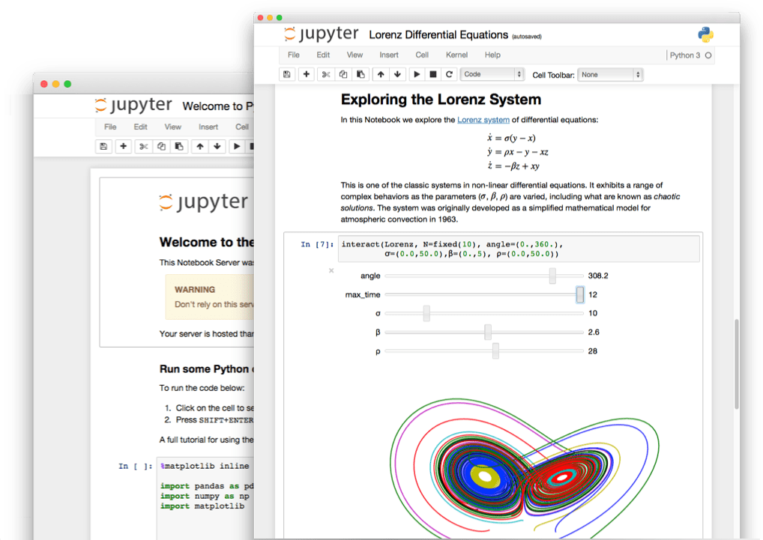
Overview Jupyter notebook
Spring 2019 - week #1
Notes:
J

Slide 46
What is a Jupyter notebook?
Open source web application
Development started in 2014 as spin-off from IPython
Notebooks denotes documents that contain both
Code, and rich text elements (figures, links, equations, etc)
Notebook documents produced by the Jupyter Notebook App
Client-server application to edit and run notebooks
Two main components: the kernels and a dashboard
Jupyter is a loose acronym meaning Julia, Python and R
Nowadays, Jupyter supports many other languages
Notes:
You could basically do many different things with a notebook… but it is heavily used these days to
Show a simple example:
a = 2
b = 3
Let’s compute $c = a^2 + b^2$
c = a**2 + b**2
print(c)
# & show \sqrt{.} in Latex
Show how to insert an image in a Markdown Cell
![alt text](Pictures/Compteur_Etage_1.jpg "Compteur")
https://github.com/adam-p/markdown-here/wiki/Markdown-Cheatsheet
Show how to time block of code (cell) - %%timeit x = range(10000) max(x)

Slide 47
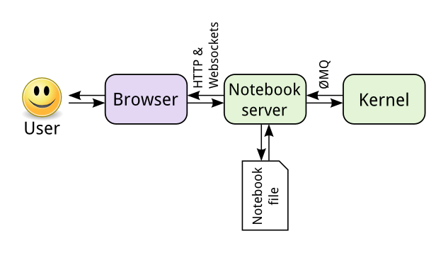
Jupyter is language-agnostic
The notebook server is responsible for saving and loading notebooks
The notebook is saved as a JSON file
The kernel gets sent cells of code to execute
Notes:
When you save a notebook, this is sent from your browser to the notebook server, which saves it on disk as a JSON file with a .ipynb extension.
JSON (JavaScript Object Notation) is a language-independent, human-readable open-standard file format (attribute-value pairs). It was derived from JavaScript.
The kernel doesn’t know anything about the notebook document: it just gets sent cells of code to execute when the user runs them.
** Show command lines as I create two new notebooks
** Explain that, as discussed before, we could install more kernels

Slide 48
Setting up a Python 2 kernel
We are running Jupyter on Python 3
Let’s set up a Python 2 kernel using conda
~ conda create --name ipykernel_py2 python=2 ipykernel
~ conda activate ipykernel_py2
~ python -m ipykernel install --user
Notes:
Edit ~/.local/share/jupyter/kernels/python2/kernel.json
-> Python 2 => Old Python
Rerun the %%timeit example

Slide 49

Crash-course in Python 3.x
Spring 2019 - week #1
Notes:
J

Slide 50
Brief history of Python
Open source programming language
Conceived in the Netherlands by Guido van Rossum
Implementation started in December 1989
Python 2.x is legacy, Python 3.x is the present & future of the language
Python 2.0 released on October 16, 2000 (current: 2.7.15)
Python 3.0 released on December 3, 2008 (current: 3.7.2)
High-level, portable, interpreted, object-oriented
Notes:
2.7: 2010
3.6: late 2016
Guido van Rossum (the original creator of the Python language) decided to clean up Python 2.x properly, with less regard for backwards compatibility than is the case for new releases in the 2.x range. The most drastic improvement is the better Unicode support (with all text strings being Unicode by default) as well as saner bytes/Unicode separation.

Slide 51
Why Python?
Easy, Fast & Broad
Python Has a Healthy, Active and Supportive Community
Plenty of documentation, guides, tutorials and more
Incredibly active developer community
Python Has Some Great Corporate Sponsors
Google!
Python has Extensive Libraries
Notes:
C# has Microsoft
Java had Sun
PHP is used by Facebook
Google adopted Python heavily back in 2006

Slide 52
Python 3.x references
https://docs.python.org/3.7/tutorial/
Books include:
Learning Python by Mark Lutz
Python Essential Reference by David Beazley
Python for Data Analysis by William McKinney
https://github.com/justmarkham/DAT8#python-resources
Python Quick Reference
https://github.com/justmarkham/python-reference

Slide 53
Common pitfalls in Python
Incorrect indentation, tabs and spaces
Never use tabs, only spaces (4)
Using a mutable value as a default value
Scoping (local vs global variable)
Copying vs referencing (mutable types)
Notes:
def foo(param=None):
if param is None:
param = []
param.append(9)
return(param)
=====
bar = 42
def foo():
bar = 0 # !! bar = bar + 0 => local variable 'bar' referenced before assignment
# return(bar)
# bar = foo()
foo()
print(bar)
=====
b = a[:] same as b = a.copy()
=====

Slide 54
A few exercises in Python
Download the DSLab Week 1 Jupyter notebook
https://dslab2019.github.io/notebooks/DSLab_week1_CCPython.ipynb
Generators
List comprehension
Lambda Operator and the functions map() and reduce()
Lists of characters and the functions join() and append()

Slide 55
Thank you!

Slide 56
Next week: Python libraries for (aspiring) data scientists
NumPy: Work with large multidimensional arrays and matrices
Pandas: Do data wrangling
Matplotlib: Make line graphs, pie charts, histograms, etc
Scikit-learn: Build machine learning models
Notes:
Scikit-learn built on top of Sci-pi

